Slide 1
Analysis of Glassdoor Reviews for competitors - CME (Chicago Mercantile Exchange)

Slide 2
Agenda
Executive Summary
Overall word cloud for Pros and Cons
What people liked (based on 5 star ratings)
What people liked (based on 4 star ratings)
What people liked (based on 3 star ratings)

Slide 3
Executive Summary
Objectives
Scrapping Glassdoor reviews for competitors given by their employees.
Analyzing reviews of competitors
Identify hidden patterns in data about employee engagement.
Key Observations
We scrapped close to 90% of reviews.
Total 540 reviews were analyzed.

Slide 4

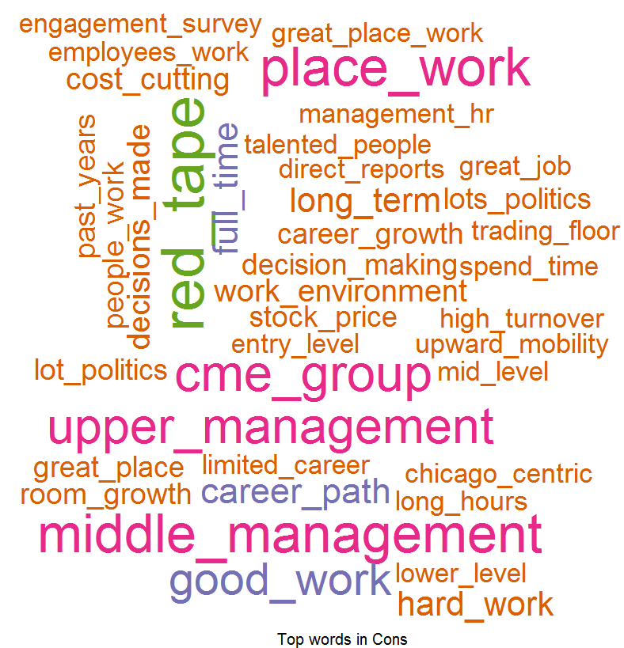
Overall Word Cloud for Pros and Cons
Word Cloud for Pros
Word Cloud for Cons
Good Words List –
Work life balance
Great Benefits
Good work
Free food
Great Culture
Health insurance
Word List which people don’t like –
Senior management
Work life balance
Red tape
Middle management
Upper management
Career path
Career advancement
Lots of politics

Slide 5
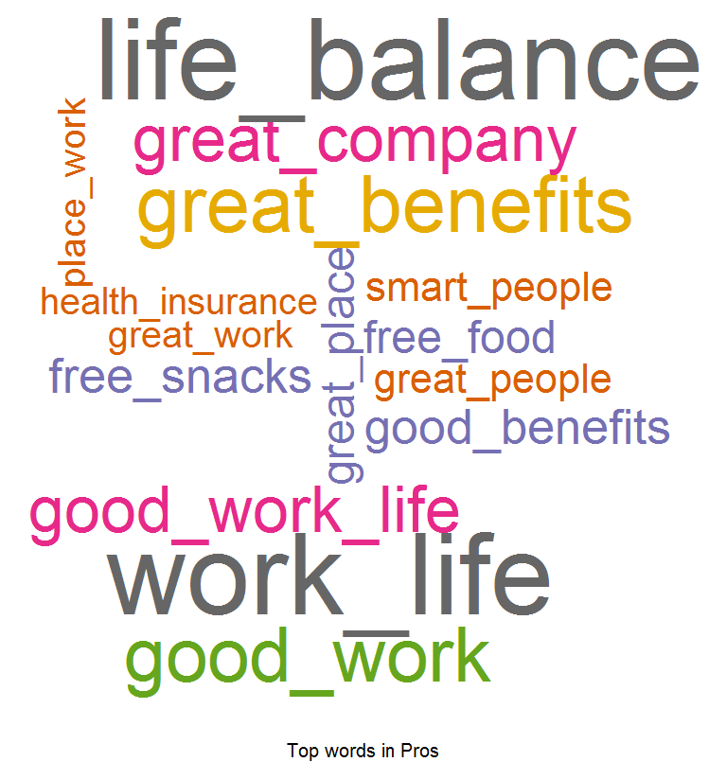
What people liked (based on 5 star ratings)
Word Cloud for Pros
Good Words List –
Work life balance
Great Benefits
Good work
Great company
Great benefits
Free snacks
Great place
Free food
Great People
Health insurance

Slide 6

What people liked (based on 4 star ratings)
Word Cloud for Pros
Good Words List –
Work life balance
Great Benefits
Free food
Good pay
Free snacks
Health insurance
Great work
Great culture

Slide 7
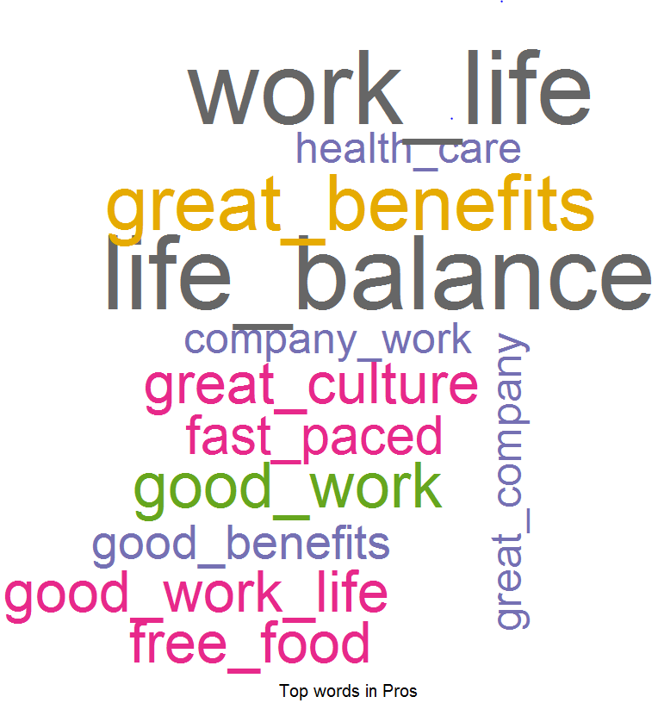
What people liked (based on 3 star ratings)
Word Cloud for Pros
Good Words List –
Work life balance
Great benefits
Good work
Free food
Great culture
Fast paced
Great company
Health care

